Slide 1

Movie Genre Analysis
In-Depth Genre Analysis
Gustavo Borges

Slide 2
Introduction
The analysis was built based on movie genres within a dataset.
It covers a wide range of perspectives, for instance you would want to know the genre with best average ratings, or what are the average ratings by genre.
The main perspective is: Movie Genres versus Ratings.
In the following slides, you will discover in depth how to look at the Dashboard to gather the informations you need.

Slide 3
The Dashboard

Slide 4
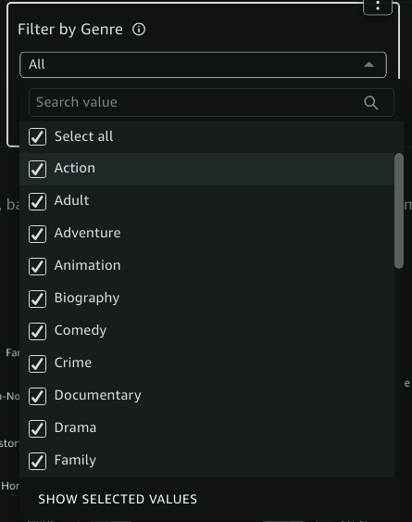
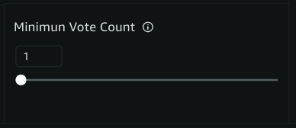
At the top of page you will find two filter options:
Filter by genre: This option allows you to see only the genres you want to explore. Changes in this filter will refresh the first graph.
Minimum vote count: Set a minimum number of votes to be consider on “Best Average Rating” graph.

Slide 5
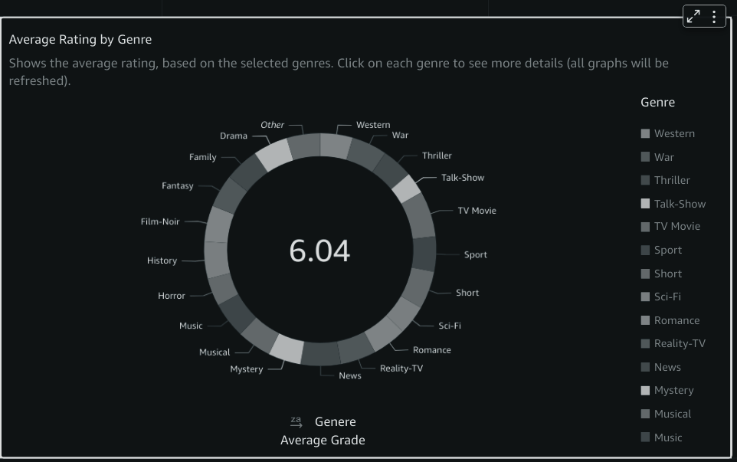
Average Rating by Genre
This graph shows all genres you have to make your analysis. You can use the “Filter by Genre” option to see more details. Note: Changes in this graph will refresh all others graphs, filtering by the selected genre.

Slide 6
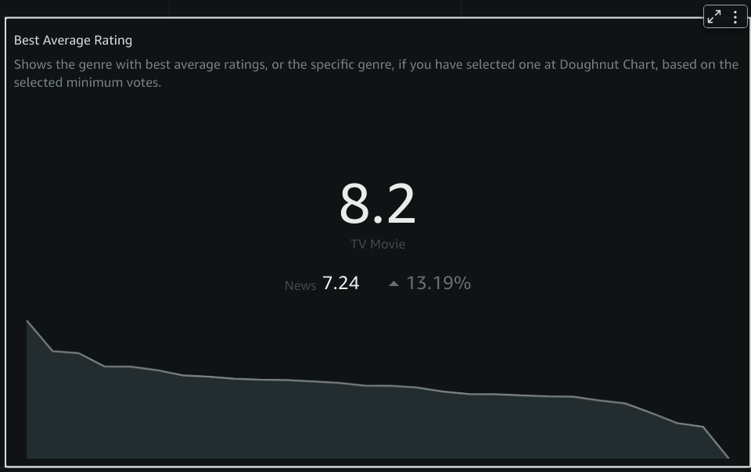
Best Average Rating
Here you can find what is the greatest genre, with the best average ratings. You can filter by setting a minimum vote quantity to be consider. Note: Be aware that the ratings and genres shifts based on vote quantity. Default is 1.

Slide 7
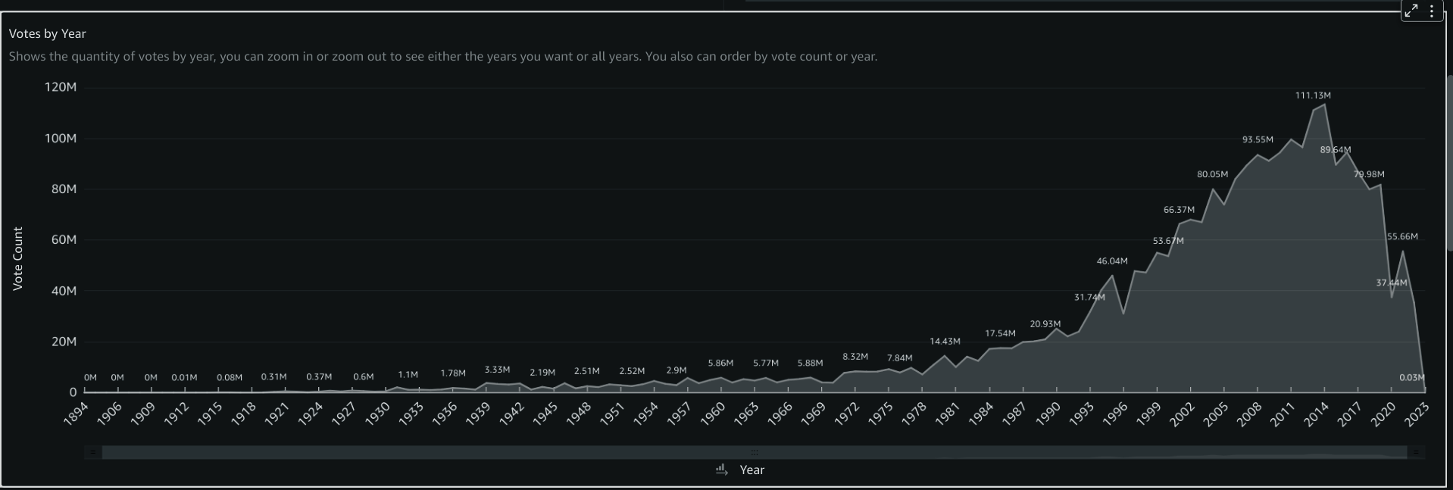
Votes by Year
Shows what is the total votes, grouped by year.
Note: At the bottom of this graph, you can use the zoom bar to focus the years you want. You can also maximize all graphs to better viewing.

Slide 8
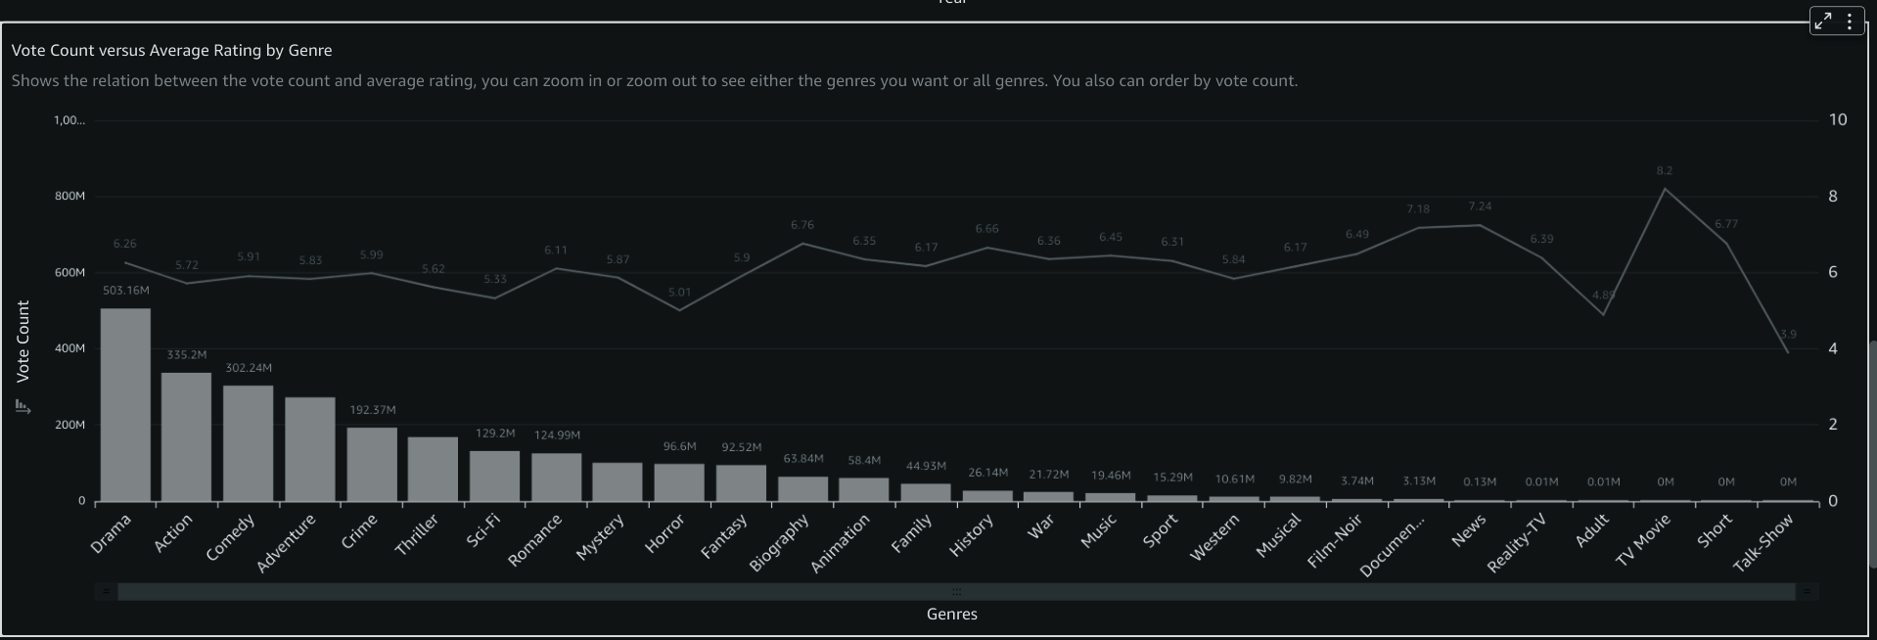
Vote Count versus Average Ratings
What is the relation between the average ratings and vote quantities? Here you can explore genre by genre and compares it.
Note: Do not forget to use the zoom bar for more detailed viewing.

Slide 9
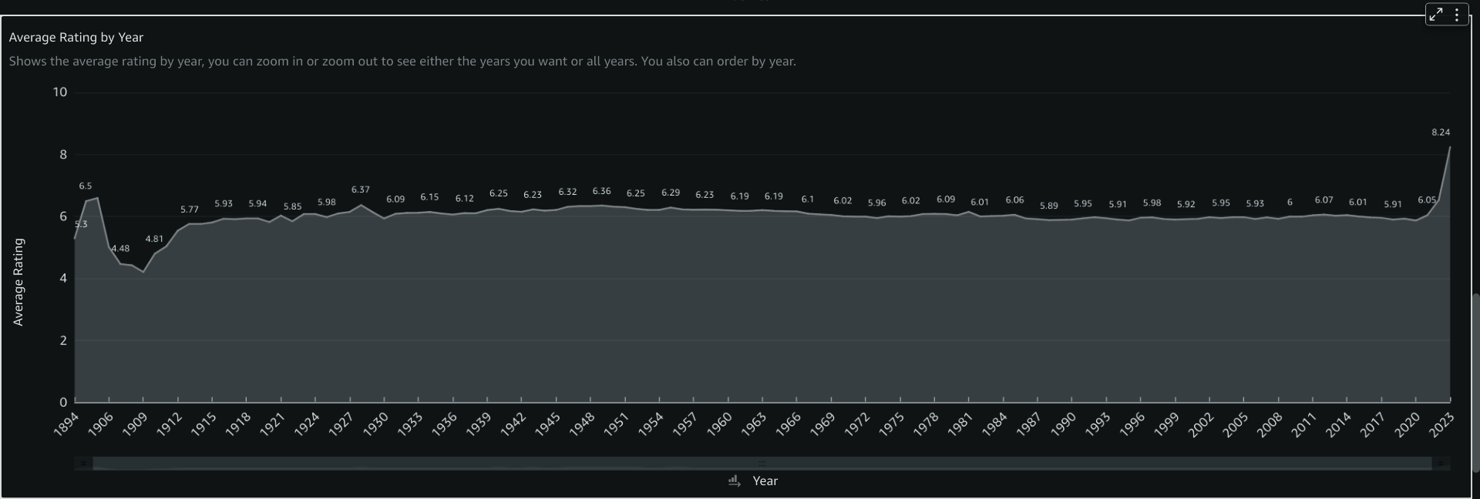
Average Rating by Year
Shows the average ratings of all genres, grouped by years. Use this graph for questions like: What was the period with lowest ratings? And the highest?

Slide 10
The Questions

Slide 11
Some Questions to Explore the Dashboard:
What are the top rated genres?
What is the genre rating by years?
If i choose to explore “Action Genre”, is there a year with more vote counts than others?
What are the average ratings for genres that have a minimum count of 10.000 votes?

